Slide 1
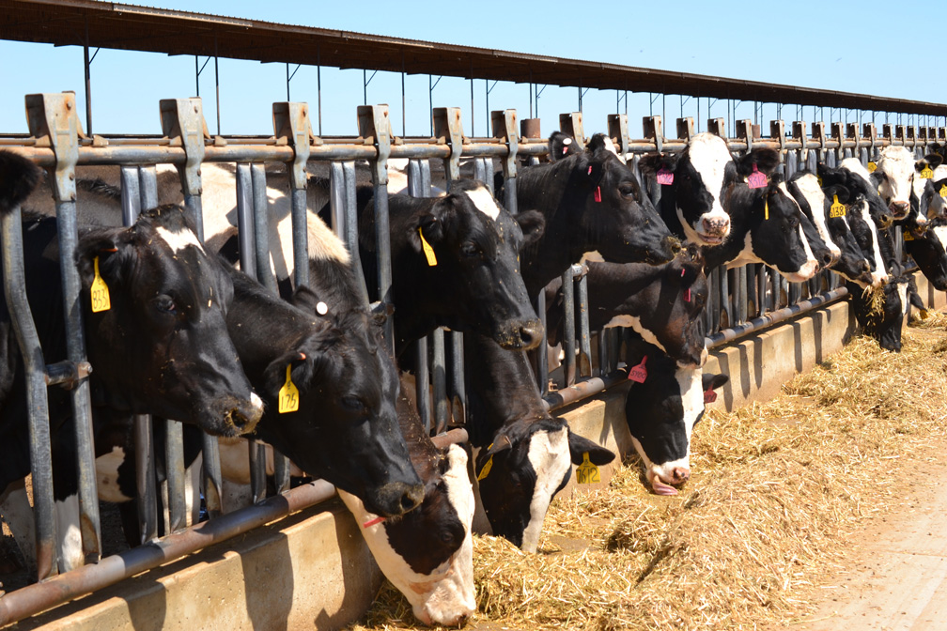
Presentation
Animal rearing and Meat production
North Western University , Khulan.

Slide 2
Presentation Topic: Comparing the animal rearing and meat-production of Bangladesh with other country.
Introduction:
The first thing that comes to our mind to compare the meat production and animal husbandry sector of any other country with the animal husbandry and meat production sector of Bangladesh is the current situation of the animal husbandry and meat production sector of Bangladesh. We need to know this in detail first and then we will discuss in a very short time what steps we can take to improve the manufacturing sector by considering the overall issues.
North Western University , Khulan.

Slide 3
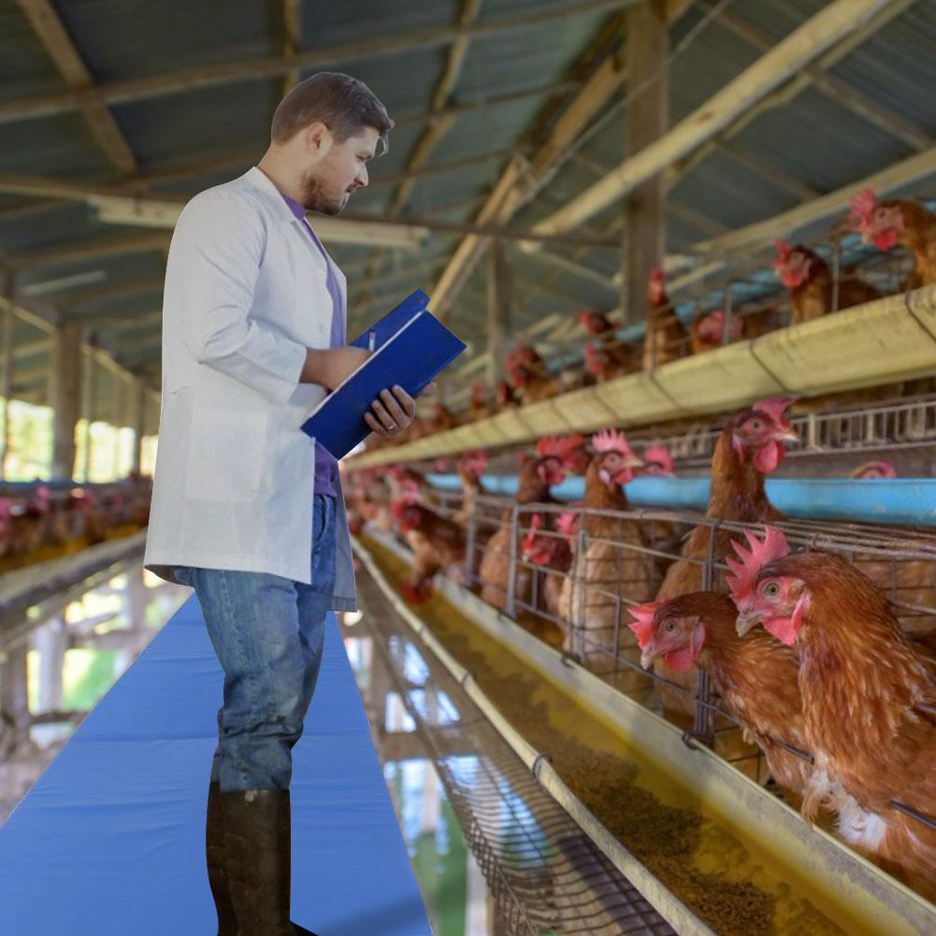
Introduction:
Animal Husbandry In Bangldesh
It is estimated that 73% of emerging human diseases are of zoonotic origin.1 Since 2003, worldwide attention to avian influenza has heightened concerns regarding the link between animal husbandry practices and emerging infectious diseases.2,3 Studies from developing countries demonstrated that contact with free-range domestic poultry increase the risk of diarrhea in children,
North Western University , Khulan.

Slide 4
4–8 and poultry farm workers and their family members are at greater risk for carriage of antimicrobial drug–resistant pathogens than the general population.7–10 The presence of antimicrobial drug–resistant bacteria in these populations is associated with animal husbandry practices, including antimicrobial drug use and proximity of humans and animals.
Inappropriate antimicrobial drug use for humans is pervasive in developing countries and is a significant contributor to the growing public health threat of antimicrobial drug–resistant bacteria.11–18 However, assessment of agricultural antimicrobial drug use in low- and middle-income countries has largely been neglected.19–25 Few studies have examined the extent of animal antimicrobial drug use in low and middle-income countries where vulnerability to drug-resistant infectious diseases is greatest.
18 In high-income countries, DNA-based analyses and other techniques have been used to identify animal antimicrobial drug use as a major risk factor for recurrent and drug-resistant human infections.26–33
North Western University , Khulan.

Slide 5
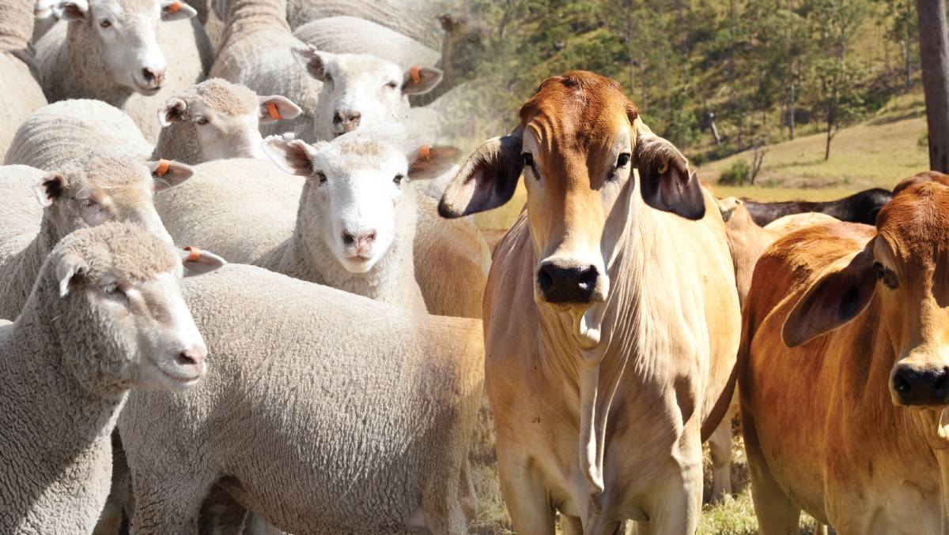
Using qualitative methods, we examined animal husbandry practices and medication use in animals and humans in rural Bangladeshi households and discusses the implications for emerging diseases, including infections from antimicrobial drug–resistant bacteria, in low and middle-income countries.
North Western University , Khulan.

Slide 6
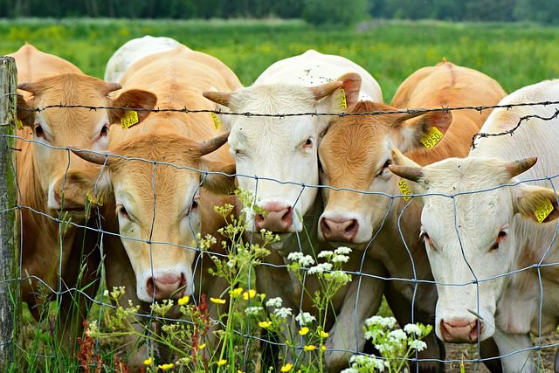
Methods:
The study was conducted in the comparison arm of the Project to Advance the Health of Neonates and their Mothers (PROJAHNMO), a three-year trial to evaluate the impact of a package of obstetric and neonatal care that includes community health education, provision of safe delivery, essential newborn care, and management of neonatal infections in northeastern Bangladesh. The methods and data collection procedures for PROJAHNMO have been described elsewhere.34 The study area is characterized by a weak health system and a high infant and child mortality rate.
North Western University , Khulan.

Slide 7
We used qualitative methods to understand local animal husbandry practices and knowledge of antimicrobial drugs and other medication use for animals and humans. We carried out semi-structured in-depth interviews with key stakeholders, including women who had a child < 18 months of age, and healthcare providers, and conducted field observations at animal clinics and medicine stalls.
Semi-structured in-depth interviews conducted by trained anthropologists (NA, AA, and DA) with women from 42 households in the comparison arm of PROJAHNMO identified factors associated with transfer of microbes between animals and humans. The interview guides were developed on the basis of a literature review and in consulation with the anthropologists to ensure themes of interest are covered. Twenty-six interviews focused on animal health practices in households and 16 focused on health-seeking and medicine use for humans. To be eligible for participation, women had to reside in the comparison arm of PROJAHNMO for the six months before the interview, be ≥ 18 years of age, have a baby < 18 months of age, and live in a household that owned ≥ 6 chickens.
North Western University , Khulan.

Slide 8
A list of households that met these eligibility criteria was generated from a census carried out by PROJAHNMO.34An equal number of households were randomly selected from low (≤ 1 U.S. dollars/day), medium (1.01–3.99 U.S. dollars/day), and high (> 4 U.S. dollars/day) socioeconomic groups to identify differences in animal husbandry practices by socioeconomic status. With this sample size, we expected to reach saturation of themes in each of the three groups. Average household size was eight persons. Women with young children were selected because they were believed to be a good source for information on human and animal medicine use and health care and were most likely to be home during the day when interviews were conducted.
Interviewers were trained to observe animal husbandry practices and record information from the interview and from packages of medicine or prescriptions available in households for either human or animal use, including the medicines' name, producer, source, cost, size, color, odor, indications, use, and outcome for each medicinal treatment. In most instances, other household members were present during interviews and supplemented observations and information provided by the women. Interviews were tape-recorded and interviewers documented the mood, tone, and environment. Interviewers expanded these notes within three days of the interview.
North Western University , Khulan.

Slide 9
Interviews were conducted with an additional 37 women who met the above inclusion criteria to learn about the village doctor network by using a structured form. Participants were asked to name the three most popular village doctors in the area and whether they treated children, adults and/or animals, and whether they sold medications. We asked each woman to name an animal doctor if she had not already done so.
Semi-structured in-depth interviews with 10 village doctors/drug sellers who were most often identified by the 37 women were conducted to learn about their prescribing practices, training, information sources, and medicine suppliers. Information obtained included recent human and animal medicines sold, most popular medicines, most common human and animal illnesses, and knowledge of antimicrobial distribution policies. Because of the sensitivity of this topic, interviews were not tape-recorded and only abbreviated notes were taken in the field and expanded within three days of the interview.
North Western University , Khulan.

Slide 10
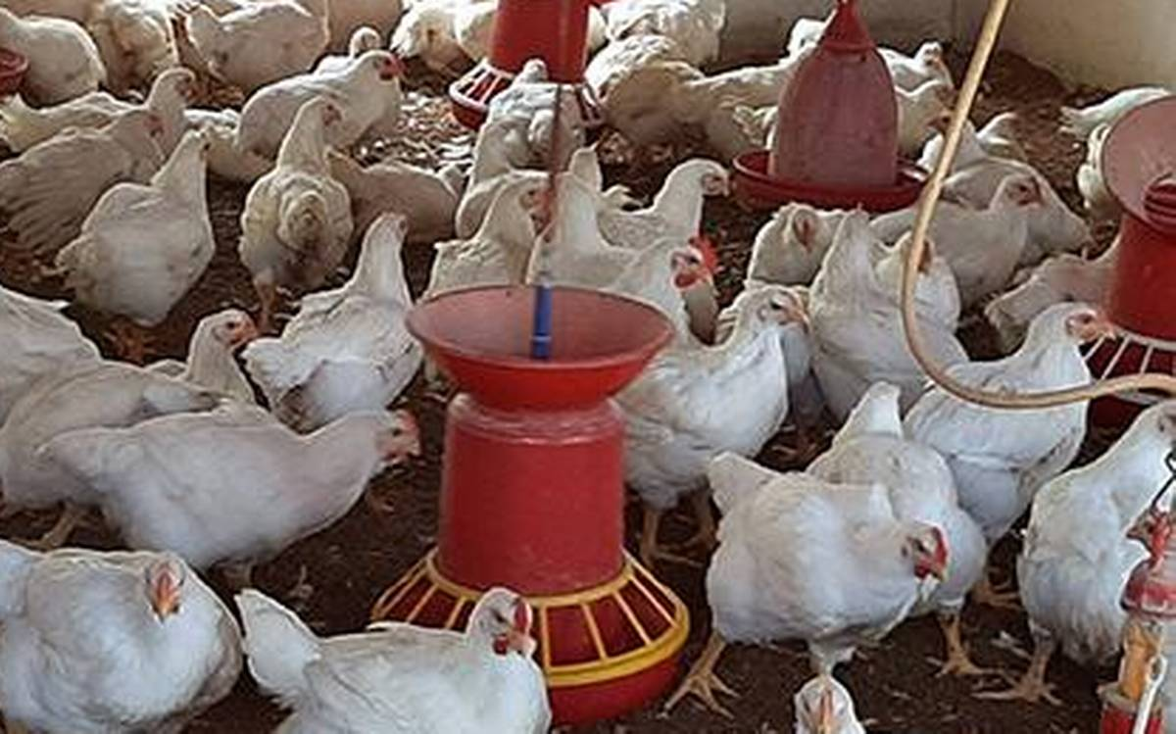
Animal Husbandry In India
In India, Animal Husbandry is making a significant contribution to the national economy and socio-economic development of the country. With >11% of world's livestock population, India stands first in buffalo population, second in cattle and goat population, third in sheep and fifth in chicken world over with bovine population of 303.76 million, 148.88 million goats, 74.26 million sheep, 9.06 million pig, 0.25 million camels and 851.81 million poultry as per 20th livestock census (2019).
India stands number one in world for total milk production with an estimated milk production of 187.7 million tonnes (2019-20) with an average yearly growth of over 6 percent and per capita milk availability of around 394 grams per day (2018-19) which is higher than the world average.
North Western University , Khulan.

Slide 11
Poultry industry which provides economic source of animal protein has taken a quantum leap in the last few decades evolving from a near backyard practice to a venture of industrial promotion. The egg production is 103.3 billion (2018-19) with an annual growth rate of >7% with per capita availability of 79 eggs (2018-19). Meat production including poultry is 8.1 million tonnes (2018-19). India is the second largest producer of fish and the second largest producer of fresh water fish in the world. The total fish production in 2018-19 was 13.75 million metric tonnes (4.15 million metric tonnes of marine and 9.58 million metric tonnes of inland fisheries).
The total contribution of livestock sector at current prices is about Rs. 10,436.56 billions (2017-18) which is 33.25% of the GDP from agriculture and allied sector. Whereas the Fisheries sector with gross value out of Rs. 2129.15 billions (2018-19) contributes 1.12% to the total GDP of the nation.
The animal husbandry, dairying and fisheries sector plays a significant role in supplementing family incomes and generating employment in the rural sector. More than 20.5 million workers are engaged in animal farming and about 87.7% of the livestock is owned by farmers of marginal, small and semi-medium operational holdings. Around 3.82% of usually working persons are engaged in Animal Production, Mixed farming, Fishing and Aquaculture during 2017-18.
North Western University , Khulan.

Slide 12
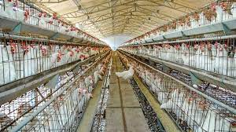
The animal husbandry and allied sectors have a vast infrastructural support from the government of India. In year 2018-19, there were 12,076 Veterinary hospitals and polyclinics, 25,571 Veterinary dispensaries and > 28,168 Veterinary aid centres. India has one of the largest breeding infrastructures in the world (56 frozen semen stations and 1,29,507 artificial insemination centres) which has performed 78.7 million artificial inseminations in 2018-19. Veterinary education too is gaining lot of emphasis. The country has 13 State Veterinary Universities and 2 Deemed Universities. There are currently 58 Veterinary colleges sufficing the growing requirement of human resource and their development in the country. Growth plans are on way to start another few colleges and exclusive State Veterinary universities.
North Western University , Khulan.

Slide 13
North Western University , Khulan.

Slide 14
Conclusion:
Some special measures that will help us grow the animal husbandry and meat production sector.
1. Policy for meat animal production and traceability especially buffalo and cattle, goat and pigs
2. Backward integration for rearing of animals ensuring veterinary health coverage and concentrated feed. Backward integration at the Primary Production level with individual identification and traceability would be a requirement. Forward integration of the products with the markets through establishing supply contracts with domestic retail chains, restaurants, hotels, etc., and market facilitation measures.
3. Infrastructure for meat processing plants in Kerala to cater to northern, central and southern districts (to be set up in border districts to avoid transport of live animals across the state)
4. Investment to produce high quality, safe, sustainable production of livestock and meat (Clean, Green and Ethical). Stress could be on sustainable primary production of small animals for meat like pigs and goats. In case of large animals, salvaging male buffalo calves for meat proposes could be an option. Rest of the cattle requirement for meat purpose could be sourced from outside state from identified and certified sources with regard to diseases status and management.
North Western University , Khulan.

Slide 15
5. Providing and packaging information and training to support informed and business-oriented decision-making by all the stakeholders, especially in the production and processing sectors .Skilled and technical manpower for slaughtering, processing and packaging etc. of meat. (Capacity building).
All of the improvements that we will make as a result of taking the steps outlined above ->
1. Availability of hygienic and safe packaged meat for public ( meeting standards as per FSSAI)
2. Farmers and entrepreneurs to benefit from the backward and forward linkages
3. Availability of skilled workforce
4. Substantial reduction in environmental pollution through scientific management of solid and liquid wastes
5. Impact on public health :Safe meat, clean and healthy surroundings, reduction in stray dogs, pests and rodents with consequent reduction in zoonotic diseases
6. Improved occupational health of the workers in meat sector.
North Western University , Khulan.

Slide 16
Thank You
North Western University , Khulan.

